Slide 1


Framework

Slide 2
NIMA framework, 4 layers
Impact
Process
Expertise
Skills

Slide 3
NIMA framework, impact
Professional marketeer
Process
Expertise
Skills
The benefits
to the inidvidual professional,
to the business and
to the economy & society overall

Slide 4
NIMA framework, process
Professional marketeer
Expertise
Skills
Analyse
Strategise
Execute
The way marketeers work

Slide 5
NIMA framework, expertise
Professional marketeer
Skills
Analyse
Strategise
Execute
Analyse: research, insights, options
Strategise: chosen direction, branding, planning
Execute: cx, price, martech, innovation, campagne, distribution, regulations
The necessary knowledge
to deliver

Slide 6
NIMA framework, skills
Professional marketeer
Leadership, projectmanagement, financial ability, result-driven, customer-focussed, flexible, innovative, communicative, persuasive, reflective, ethical, analytical
Analyse
Strategise
Execute
Analyse: research, insights, options
Strategise: chosen direction, branding, planning
Execute: cx, price, martech, innovation, campagne, distribution, regulations
The necessary skills
to deliver

Slide 7
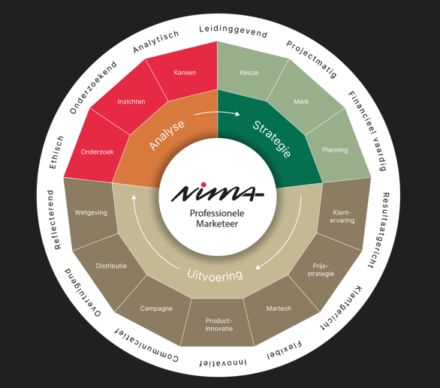
NIMA framework
The ‘wheel’ of competency of a professional marketeer

Slide 8
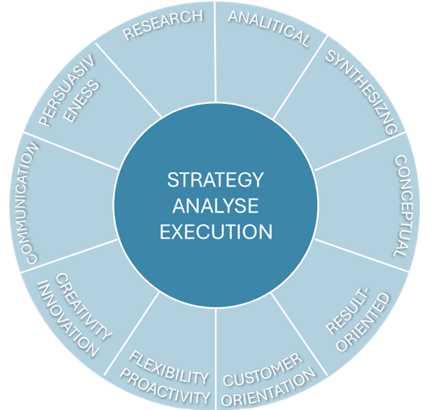
NIMA framework for assessments
The assessment ‘wheel’
10 key competencies

Slide 9
NIMA framework for assessments
Competency | Explanation
Research | Ability to gather relevant information from secondary and primary research.
Analytical | Mastery of techniques to define, structure and evaluate problems.
Synthesizing | Draw conclusions, link to issues and synthesize solutions.
Conceptual | Translate problems & solutions into implementation activities.
Result-Oriented | Set, manage and adjust measurable goals.
Customer Orientation | Involve stakeholders in analysis and recommendations.
Flexibility & Proactivity | Integrate adaptability into implementation plans.
Creativity & Innovation | Demonstrably innovative.
Communication with Audiences | Build and maintain trust with stakeholders.
Persuasiveness | Express thoughts, interact and answer correctly.
10 key competencies;
explanation per competency

Slide 10
NIMA framework
Competency levels;
knowledge, skills & responsibility
EMQF Level | Role (EMC) | Exams | Knowledge | Skills | Responsibility
Level 3 | Junior | NIMA Basic | Basic theory | Basic to find solutions | To complete tasks
Level 4 | Practitioner | NIMA A | General and relevant to the field | Specialized for field-related problems | Operate independently, supervise others, evaluate & improve activities
Level 5 | Associate | NIMA B1 | Extensive | Wide range & specialized | Supervise others in unpredictable situations, evaluate own & others’ performance
Level 6 (SMP) | Manager | NIMA B | Advanced and critical understanding of principles | Advanced & innovation to solve unforeseen problems | Responsible for complex decisions, lead teams in unpredictable situations
Level 7 | Director | NIMA C | Highly specialized, critical reflection at field & related disciplines | Specialized research & problem-solving, synthesize & integrate knowledge | Leadership & innovation in complex, unpredictable contexts, strategic responsibility
Level 8 (EMP/ RM) | CMO | NIMA RM/EMP | Most advanced | Most advanced problem-solving capacity, synthesis & evaluation | Authority, autonomy, integrity, drive innovation & research

Slide 11
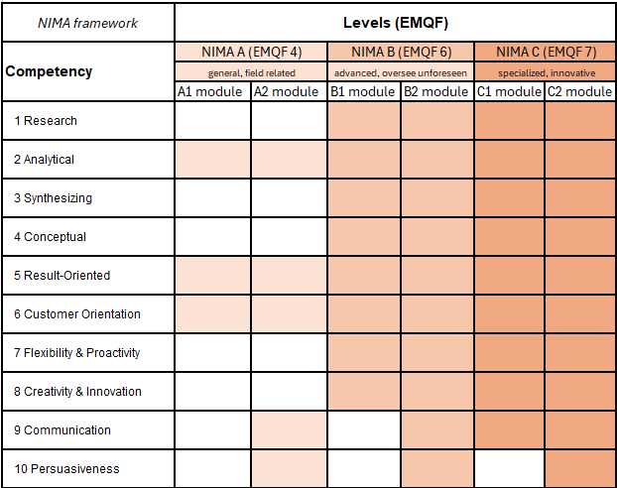
NIMA framework
Competency levels per module

Slide 12
Thank you!

Slide 13
Appendix - NLQF/ EQF levels - 8 key themes - 10 key competencies

Slide 14
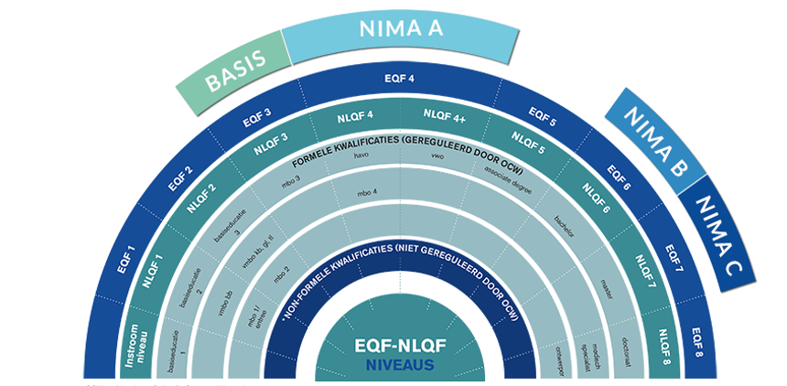
NIMA framework
Competency levels

Slide 15
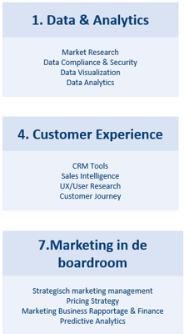
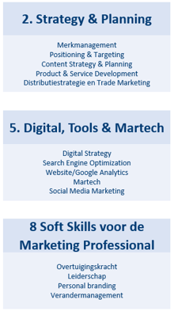
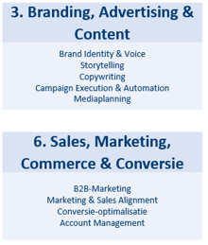
NIMA framework
8 key themes for
NIMA training & workshops

Slide 16
NIMA framework for assessments
1. Research
6. Customer Orientation
2. Analytical
7. Flexibility & Proactivity
3. Synthesizing
8. Creativity & Innovation
10 key competencies for
NIMA Qualifications
4. Conceptual
9. Communication with Audiences
5. Result-Oriented
10. Persuasiveness

